Slide 1

MULTI-CLASS PREDICTION OF OBESITY RISK
THYNK UNLIMITED
WE LEARN FOR THE FUTURE
USING DECISION TREE CLASSIFIER AND RANDOM FOREST CLASSIFIER
PRESENTED BY:
CARPIO
CONCEPTION
DONATO

Slide 2
PRESENTATION OUTLINE
INTRODUCTION
ABSTRACT
REVIEW OF RELATED LITERATURE
METHODOLOGY
RESULTS AND DISCUSSION
CONCLUSION

Slide 3
INTRODUCTION
Obesity has become a critical public health challenge worldwide
particularly in Latin America
due to lifestyle and dietary factors unique to individual behaviors.

Slide 4
ABSTRACT
This study utilizes machine learning algorithms, specifically the Decision Tree Classifier (DTC) and Random Forest Classifier (RFC), to predict obesity risk categories, achieving an accuracy of 85% and 90%, respectively. The findings emphasize the superior capability of the RFC in identifying normal weight individuals and those at risk of obesity, underscoring the potential of machine learning for informed healthcare interventions.

Slide 5
PROPOSED SOLUTION
Machine-Learning-based Assessment Model
uses:
Classification
Prediction
Segmentation
Association
to categorize obesity level

Slide 6
SIGNIFICANCE OF THE PROBLEM?
CURRENT SOLUTION?
IMPACTED GROUPS
Generalized Health Assessments
Metrics systems (BMI)
Individuals facing obesity or at risk

Slide 7
POTENTIAL USERS
APPLICATION OF THE SOLUTION
Public Health Agencies
healthcare providers
fitness professionals
nutritionists and
developers of health-focused mobile applications
clinics
wellness centers
digital health platforms, and
educational programs

Slide 8
METHODOLOGY
Data Collection
Random Forest
Data Pre-Processing
Decision Tree
Modelling
Evaluation

Slide 9
A
DATA COLLECTION
Data were obtained from an online repository
The datasets contain both categorical and numerical features, with the goal variable named NObeyesdad, which reflects the obesity risk level.

Slide 10
A
B
DATA PRE-PROCESSING
Features Used: relevant variables were utilized
Handling Categorical Data: categorical features have been encoded using label encoding
Scaling: numerical features were standardized
Splitting the data: data that was processed was divided into 80% training and 20% testing sets

Slide 11
A
B
C
EXPERIMENTAL SETUP
Python language used
Essential libraries such as pandas, numpy, scikit-learn, and seaborn.
Scikit-learn models include DecisionTreeClassifier and RandomForestClassifier.

Slide 12
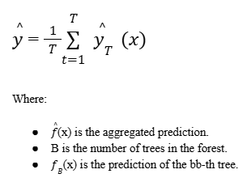
A
B
C
D
ALGORITHM: RANDOM FOREST
This strategy is especially efficient for decreasing overfitting and improving the model's generalization capabilities.
During training, the Random Forest algorithm generates many decision trees and produces their mode or mean
Equation

Slide 13
A
B
C
D
ALGORITHM: DECISION TREE
Decision trees are commonly used for classification and regression applications due to their interpretability and ease of visualization.
The basic idea underlying a decision tree is to iteratively split the dataset into subsets depending on features that produce the "best" split.

Slide 14


A
B
C
D
ALGORITHM: DECISION TREE
IMPURITY MEASUREMENTS:
Gini Impurity:
Entropy:
Variance:

Slide 15

A
B
C
D
ALGORITHM: DECISION TREE
INFORMATION GAIN:
The "best" split is the one that optimizes information gain while minimizing impurities.

Slide 16
A
B
C
D
ALGORITHM: DECISION TREE
DECISION RULE FOR EACH NODE:
for each of the nodes, the decision tree selects the feature and criterion that result in the greatest information gain

Slide 17
A
B
C
D
E
TRAINING PROCEDURE
Challenges:
Decision trees are susceptible to overfitting on smaller datasets. Random Forest addressed this by using ensemble averaging.
Strategy Alignment: The Random Forest algorithm is consistent with modern collaborative learning methodologies, resulting in increased stability and accuracy.

Slide 18
A
B
C
D
E
F
EVALUATION METRICS
METRICS USED TO EVALUATE THE MODEL:
Accuracy
Precision
Recall
F1-Score
AUC (Area Under the ROC Curve) Macro Average and Weighted Average
Confusion Matrix
Cross-Validation Scores
Mean Cross-Validation Score

Slide 19
A
B
C
D
E
F
EVALUATION METRICS
RATIONALE FOR CHOOSING THESE METRICS:
AUC, Precision, and Recall are particularly relevant as they provide insights into how well the model distinguishes between classes
Macro and weighted averages ensure that each class is adequately represented in the evaluation

Slide 20
A
B
C
D
E
F
EVALUATION METRICS
MODEL EVALUATION AND COMPARISON:
Final model accuracy score
Cross-validation and the confusion matrix were further analyzed to identify areas of potential misclassification

Slide 21
A
B
C
D
E
F
G
BASELINES AND COMPARATIVE MODELS
Model performance was evaluated using the following metrics: accuracy, precision, recall, and the F1 score
Metric Justification: Given the classification objective, the F1 Score is especially important for unbalanced classes.
Result Comparison: Models were compared based on their cross-validation scores and final test set performance

Slide 22
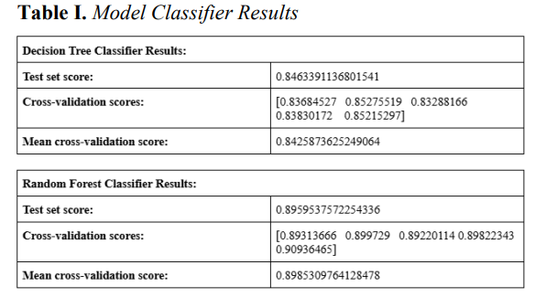
RESULTS AND DISCUSSION
KEY FINDINGS

Slide 23
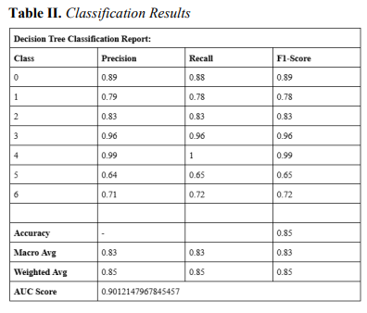
RESULTS AND DISCUSSION
CLASSIFICATIONS

Slide 24
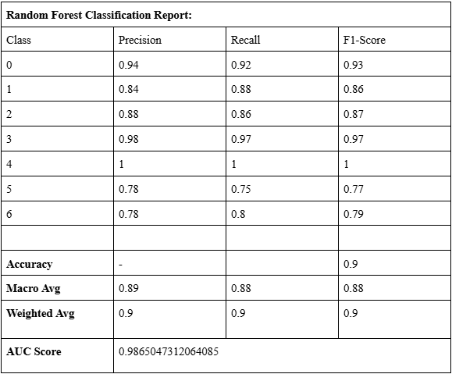
RESULTS AND DISCUSSION
CLASSIFICATIONS

Slide 25
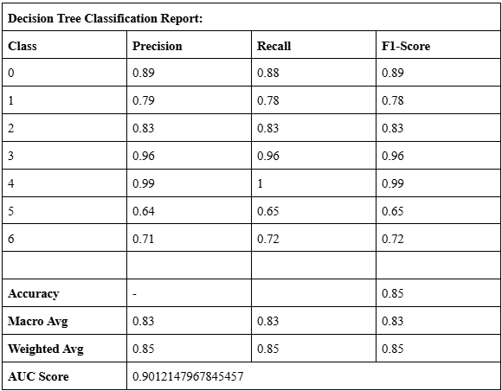
RESULTS AND DISCUSSION
CLASSIFICATIONS

Slide 26
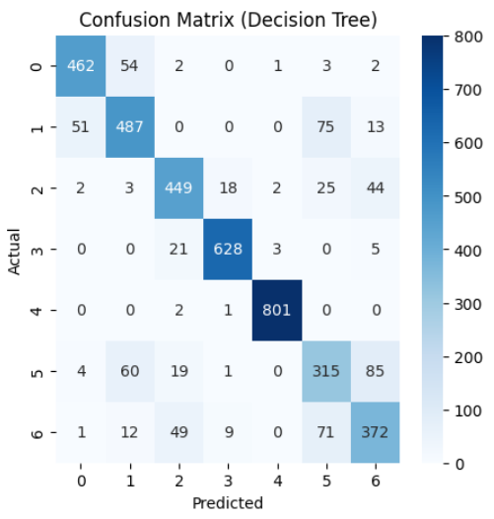
RESULTS AND DISCUSSION
DECISION TREE CONFUSION MATRIX

Slide 27
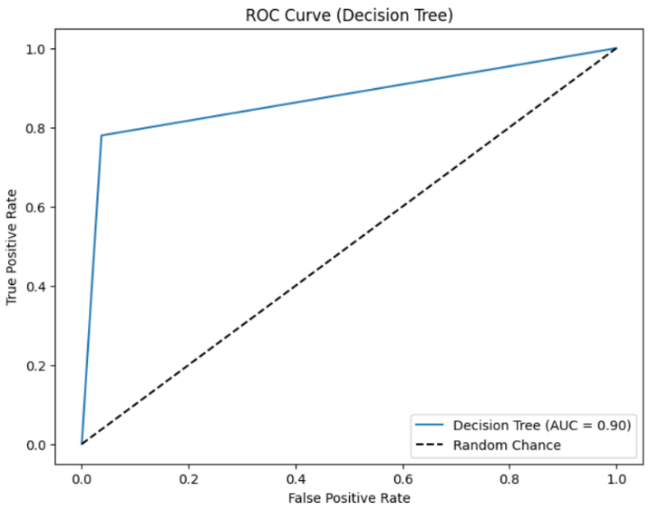
RESULTS AND DISCUSSION
DECISION TREE AUC GRAPH

Slide 28
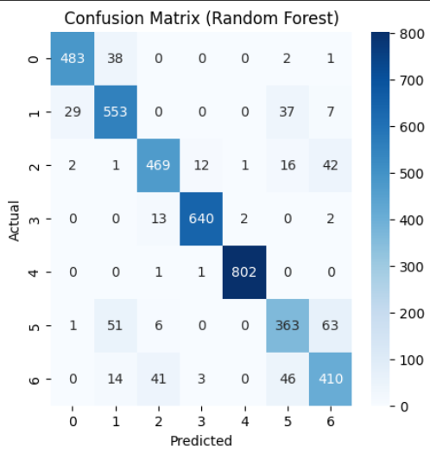
RESULTS AND DISCUSSION
RANDOM FOREST CONFUSION MATRIX

Slide 29
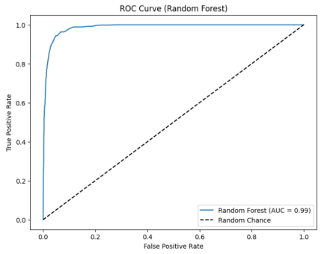
RESULTS AND DISCUSSION
RANDOM FOREST AUC GRAPH

Slide 30
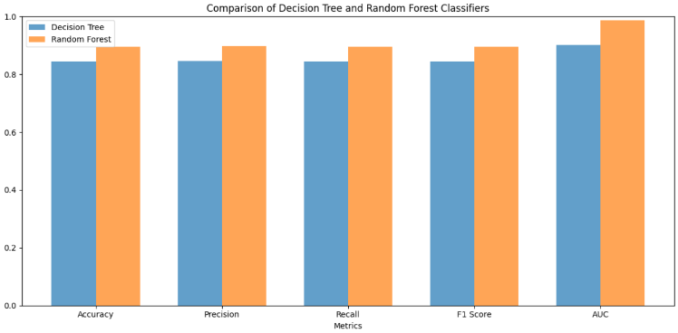
RESULTS

Slide 31
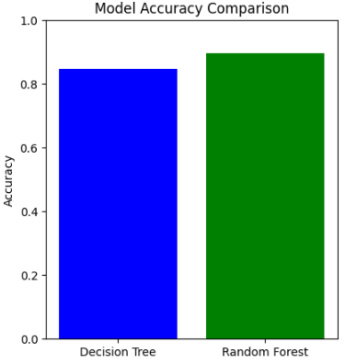
RESULTS
The result of this study showcases the strength of two models, Decision Trees, and Random Forest in analyzing the complex dataset of the study. It predicts obesity levels based on lifestyle factors. The Random Forest model significantly outperformed the Decision Tree, achieving a higher accuracy of 90% compared to 85%

Slide 32
CONCLUSION
This research addressed the critical challenge of accurately predicting obesity risk levels by incorporating complex lifestyle and dietary factors
Primary objective was to develop and evaluate machine learning models capable of multi-class prediction of obesity risk, specifically comparing the effectiveness of Decision Tree Classifier (DTC) and Random Forest Classifier (RFC) algorithms.

